Slide 1
HEAT PUMPS

Slide 2
Outline
Definition
Operating Principles
Types
Performance Evaluation
Applications
Issues
References

Slide 3
Definition
A heat pump is a device that provides heat energy from a source of heat to a destination called a "heat sink". Heat pumps are designed to move thermal energy opposite to the direction of spontaneous heat flow by absorbing heat from a cold space and releasing it to a warmer one.
Provides Heat.
Provides Cooling.
Operates on Electricity.
Cost Effective.
Examples: Refrigerators, Air Conditioners.

Slide 4
Definition
The term “heat pump” in a broader sense applies to numerous heating, ventilating, and air conditioning (HVAC) devices employed to heat or cool spaces.
Air at –18°C contains about 85 percent of the heat it contains at 21°C. This ability of the ground and air outside buildings to retain a considerable amount of heat is very well exploited by a heat pump which can be used to cool and condition air inside buildings, as in air conditioners, as well as heat buildings on cold days.

Slide 5
Operating Principles
A heat pump can absorb heat from a cold space and release it to a warmer one, but, heat energy is not conserved in this process, which requires some external high grade energy with less entropy such as electricity for the movement of heat in a direction opposite to the natural course of flow.
The working of a heat pump can be represented mathematically by models known as the heat pump / refrigeration cycles.
In this light, a heat pump can be thought of as a heat engine which is operating in reverse.

Slide 6
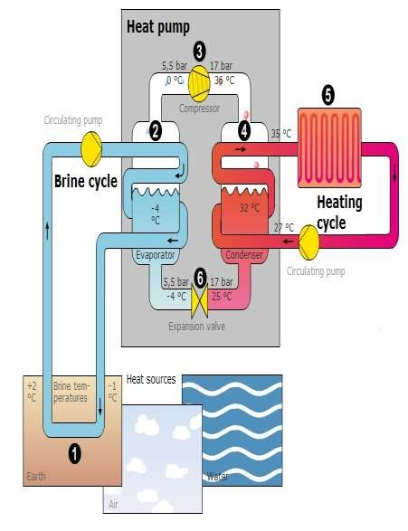
Operating Principles

Slide 7
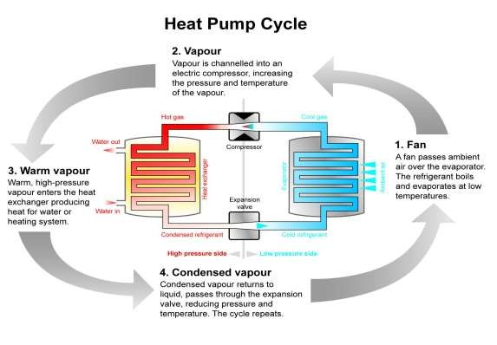
Vapour-Compression Cycle

Slide 8
Vapour-Absorption Cycle
The various processes of the vapor absorption cycle are similar to the one in vapor compression cycle, only the method of compression of the refrigerant is different.
In vapor absorption system ammonia is used as the refrigerant, which has very high affinity to dissolve in water.

Slide 9
Vapour-Absorption Cycle
Absorption of refrigerant: In vapor absorption system there is no traditional compressor, instead there is absorber. The absorber consists of water, called as absorbent, in which the refrigerant, ammonia, dissolves.
This mixture of water and ammonia is then pumped and heated thus increase in temperature and pressure of the ammonia occurs.

Slide 10
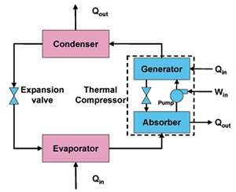
Vapour-Absorption Cycle
The amount of electricity required by the pump is much lesser than that required by the compressor hence there is lots of saving of electricity, however, the additional source of heat in the form of steam has to be provided.
Variations: Water absorption system,
Lithium bromide absorption system.

Slide 11
Types
System Installed within
Heat Pump Unit itself
Motive / Generating Power input
Temperature of Operation

Slide 12
System Installed Within
Air Source Heat Pump System: Heat is extracted from ambient air drawn across its heat exchanger. Source temperature will be dependent on prevailing ambient temperature and varies through the year depending on geographic area (typical average is 6 - 8°C).

Slide 13
System Installed Within
Ground Source Heat Pump System: A closed pipe - work loop of water / antifreeze solution is buried in the ground, either vertically through boreholes or horizontally in trenches (coiled or straight in length) and the heat pump used to extract the heat. Supply temperature will be around 0 - 5°C in order to extract heat from the source at about 10°C which is most common form of “Ground source” where water is passed through the source inside a tube heat exchanger.

Slide 14
System Installed Within
Water Source Heat Pump System:
Closed Loop: a closed pipe - work loop of water / antifreeze solution is sunk into a river, lake or the sea. Supply temperature will be approximately 5°C less than the source at about 0°C.
Open Loop: where water is actually extracted from a ground Aquifer and passed through the heat pump (sometimes using a protective passive water-to-water heat exchanger). Source temperatures will be close to ground temperatures unless a heat exchanger is used, hence at about 10°C.
Other types: Water Loop Heat Pump System, Exhaust Air System.

Slide 15
Heat Pump Unit
Based simply on its source and delivery media:
Air-to-Water (A-W)
Air-to-Air (A-A)
Water-to-Water (W-W)
Water-to-Air (W-A)

Slide 16
Motive Power
Heat pumps are also sometimes designated by the fuel source used to drive the process which is most usually electricity (>95%), less commonly natural gas and much less commonly LPG.

Slide 17
Flow Temperature
For heat pumps generating hot water in their condensers (i.e. Air- or Water- to Water units) another sub description is the flow temperature capability.
Low Temperature: | 35⁰ C
Medium Temperature: | 45⁰ C
High Temperature: | 55⁰ C
Very High Temperature: | > 65⁰ C

Slide 18
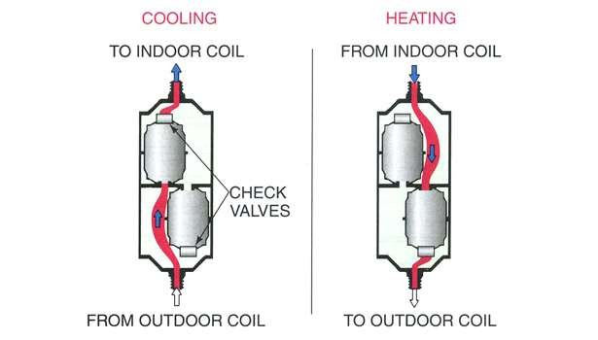
Two-Way Heat Pumps
Two - way heat pumps work in either of the thermal direction to provide cooling or heating to an internal space.
They employ a reversible valve to reverse the flow of refrigerant from the compressor through the condenser and evaporation coils.

Slide 19
Coefficient of Performance (COP): The COP is a measure of the amount of power input to a system compared to the amount of power output by that system.
_{COP =} Power Output
Power Input
The COP is therefore a measurement of efficiency; the higher the number, the more efficient the system is.

Slide 20
Consider a simple electric heater. All of the electricity that is input to the unit is converted to heat. There is no waste and the power output (in heat) equals the power input (in electricity), so the COP is one. The COP can be used to describe any system, not just heating and cooling.
The maximum theoretical COP for an air conditioning system is expressed by
Carnot’s theorem, reduced to the following equation:
COP =
T_{C}
MAX
T - T
H C
Where TC is the cold temperature and TH is the hot temperature.

Slide 21
Performance Evaluation
This means that an heat pump system is more efficient when the room temperature is closer to the outside temperature and will use more power when there is a larger difference in these temperatures.
Typical COP values for air conditioning and heat pump systems are in the range 2 to 4, or about a tenth of the theoretical maximum.

Slide 22
Energy Efficiency Ratio (EER): It is the ratio of output cooling energy (in BTU) to electrical input energy (in Watt-hour).
_{EER =} Output Cooling Energy (BTU) Input Electrical Energy (Wh)
Variations:
Seasonal Energy Efficiency Ratio (SEER):
_{EER =} Output Cooling Energy over a Season(BTU) Input Electrical Energy during the same Season (Wh)
Heating Seasonal Performance Factor (HSPF):
Output Heating Energy Input Electrical Energy
COP =
= HSPF × 0.293

Slide 23
Applications
District Heating: Drammen Fjernvarme District Heating is a district heating system in Drammen, Norway.
The heat pump was manufactured by Star Refrigeration in 2011 with 3 systems giving a combined capacity of 14 megawatts to central Drammen providing 85% of hot water needed for the city.
Refrigerant: Ammonia.
Source: Sea-Water(8 or 9°C from a depth of 18m)
District water heated to around 65 °C to 90 °C for use in building heating and hot
water systems.
Average COP=3.0

Slide 24
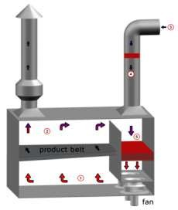
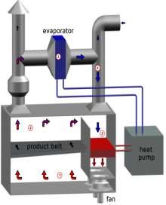
Applications
Drying: Application of a heat pump gives the possibility for waste heat recovery. With a heat pump the extracted heat from the exhaust air is upgraded to a higher temperature level and reused to heat the dryer.

Slide 25
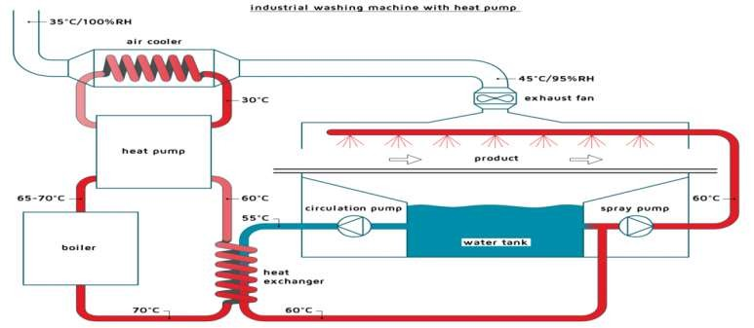
Applications
Washing: The washing installation is often equipped with an air discharge fan to prevent the installation from vapor flowing out through the inlet and outlet opening and other openings in the washing machine.
The air discharge will blow humid hot air to the ambient surrounding and will maintain an under pressure inside the washing machine. The discharge air contains a large amount of energy. With a heat pump it is possible to use the heat from the discharge air to heat the washing water.

Slide 26
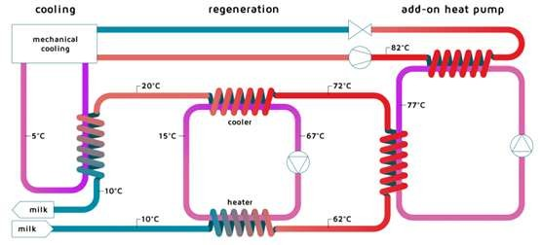
Applications
Pasteurization: In most pasteurization processes heat exchange between the cold and hot product flow is already implemented.
In addition to this extra heating and cooling are needed for pasteurization, heat pump might be the ideal solution to extract heat from the product that needs to be cooled and supply this heat at a higher temperature to the product that needs to reach pasteurization temperature.

Slide 27
Applications
Cogeneration: In designing a cogeneration, heat pumps readily compliment with many renewable energy technologies to produce desired heat and power at reduced basic fuel input.
Thus, integrating heat pumps with clean technologies becomes a potent tool in combating carbon emission. This is the direction energy engineering should be moving with all deliberate speed.

Slide 28
Applications
Desalination: Desalination is the process of converting sea water to fresh water.
Desalination plants based on mechanical vapor compression (MVC) technology are inherently the most thermodynamically efficient.
A single unit of a two-effect MVC desalination pilot plant of 50 m3/day capacity was commissioned at Trombay, Mumbai.
Thermal desalination requires lots of energy. One hybrid technology that can potentially lower energy consumption is solar-assisted heat pump as it operates at low temperature and utilizes solar energy, ambient energy and waste heat.

Slide 29
Issues
As with any heat engine till date, even heat pumps share the major flaw of constrained performance parameters due to thermodynamic efficiency limits.
Heat pumps are only highly efficient when they generate heat at a low
temperature differential, ideally around or below 32 °C (90 °F).
Both indoor and outdoor heat pump units contain moving mechanical components which produce noise.

Slide 30
References
"Heat Pump," [Online]. Available: https://en.wikipedia.org/wiki/Heat_pump. [Accessed April 2016].
“The Refrigeration Cycle,” [Online]. Available: http://www.air-n-water.com/how-a-heat-
pump-works.htm. [Accessed April 2016].
“Applications,” de Kleijin, [Online]. Available: http://www.industrialheatpumps.nl/en/applications/. [Accessed April 2016].
Kommunal, "District heating with 90% Renewable Energy," 2009.
Animation for reference:
http://www.dimplex.de/fileadmin/dimplex/downloads/animationen/waermepumpe.swf

Slide 31
THANK YOU! ☺

